Slide 1
CFReDS
디지털포렌식트랙
김태룡

Slide 2
INDEX
+ CFReDS
+ Process
+ Result
CFReDS

Slide 3
CFReDS
CFReDS

Slide 4

04/33
CFReDS
Computer Forensic Reference Data Sets
National Institute of
Standards and Technology
CFReDS

Slide 5



05/33
CFReDS
National Institute of
Standards and Technology
Computer Forensic Reference Data Sets
Tool Test
Proficiency Test
Training
CFReDS

Slide 6
06/33
CFReDS
Tool Test
Proficiency Test
Computer Forensic Reference Data Sets
Training
CFReDS

Slide 7
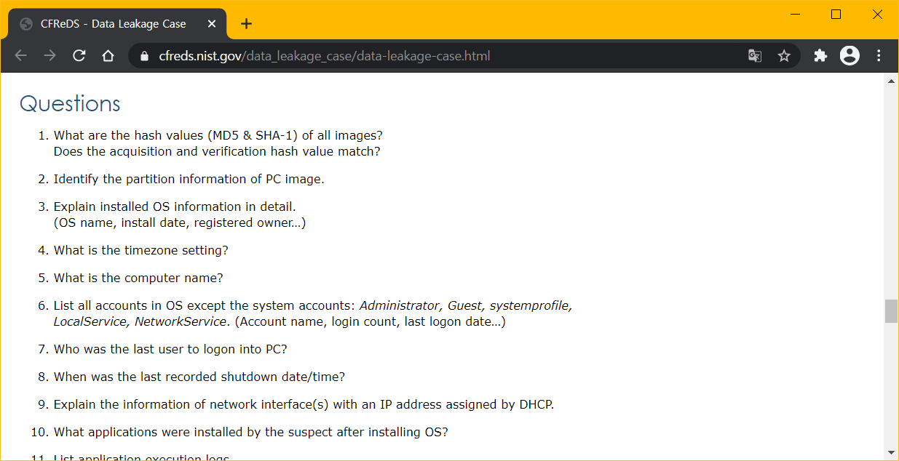
07/33
CFReDS
CFReDS

Slide 8
Process
CFReDS

Slide 9



09/33
Process
Data Leakage Case
Given data
x2
PC Image
USB Image
CD Image
CFReDS

Slide 10
10/33
Process
Data Leakage Case
Questions
01. What are the hash values (MD5 & SHA-1) of all images?
02. Does the acquisition and verification hash value match?
…
59. List and explain methodologies of data leakage performed by the suspect.
60. Create a visual diagram for a summary of results.
CFReDS

Slide 11
11/33
Process
Data Leakage Case
Dramatized Questions
유명 국제기업 A에서 기술 개발 부서장으로 일하는 'Iaman Informant'가 보안 검색대를
통과하던 도중, 승인되지 않은 저장장치(USB 및 CD)가 검색되었으며, 현장에서 즉시 내용물을
확인하였으나 데이터 유출 흔적을 발견할 수 없었기에 추가 조사를 위하여 사내 디지털포렌식
팀으로 인계되었습니다.
Mentor : Encourage the use of open source tools.
CFReDS

Slide 12



12/33
Process
Mentor : Encourage the use of open source tools.
CFReDS

Slide 13
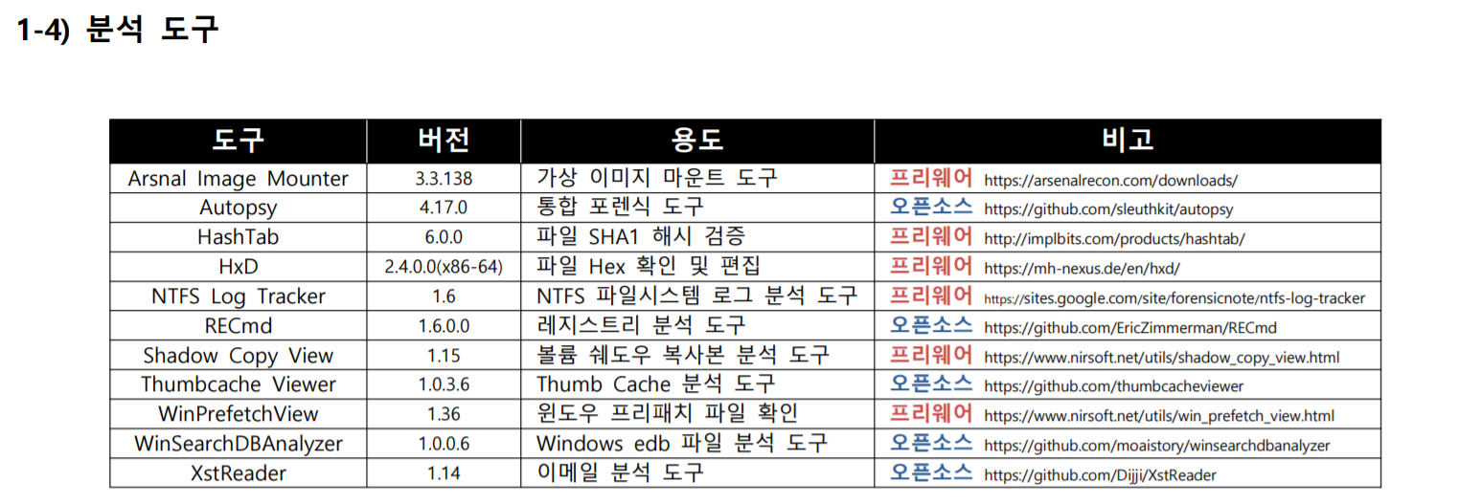
13/33
Process
Mentor : Encourage the use of open source tools.
CFReDS

Slide 14
14/33
Process
x2
USB Image
CD Image
PC Image
CFReDS

Slide 15


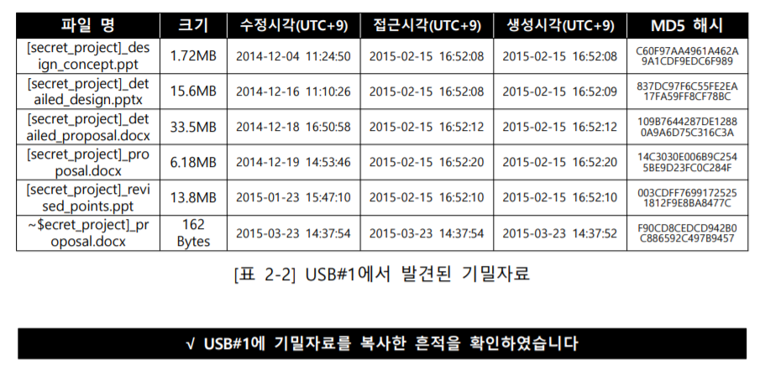
15/33
Process
x2
USB Image
CD Image
PC Image
CFReDS

Slide 16

16/33
Process
StikyNote
Chrome
SearchIndexer
Outlook
Eraser
Ccleaner
GoogleDrive
InternetExplorer
Word
Prefetch
PC Image
CFReDS

Slide 17

17/33
Process
“Tomorrow... Everything will be OK...”
D-1
StikyNote
Chrome
SearchIndexer
Outlook
Eraser
Ccleaner
GoogleDrive
InternetExplorer
Word
Prefetch
Autopsy
CFReDS

Slide 18




18/33
Process
StikyNote
Chrome
SearchIndexer
Outlook
Eraser
Ccleaner
GoogleDrive
InternetExplorer
Word
Prefetch
Autopsy
CFReDS

Slide 19
19/33
Process
GoogleDrive
Eraser
Ccleaner
StikyNote
Chrome
SearchIndexer
Outlook
Eraser
Ccleaner
GoogleDrive
InternetExplorer
Word
Prefetch
Autopsy
CFReDS

Slide 20

20/33
Process
Secret
StikyNote
Chrome
SearchIndexer
Outlook
Eraser
Ccleaner
GoogleDrive
InternetExplorer
Word
Prefetch
Autopsy
CFReDS

Slide 21




21/33
Process
spy.conspirator
iaman.informant
StikyNote
Chrome
SearchIndexer
Outlook
Eraser
Ccleaner
GoogleDrive
InternetExplorer
Word
Prefetch
XstReader
CFReDS

Slide 22




22/33
Process
Deleted
$LogFile
$UsnJrnl_$J
$MFT
StikyNote
Chrome
SearchIndexer
Outlook
Eraser
Ccleaner
GoogleDrive
InternetExplorer
Word
Prefetch
NTFS Log
Tracker
CFReDS

Slide 23

23/33
Process
Deleted
$LogFile
$UsnJrnl_$J
$MFT
사직서 인쇄
StikyNote
Chrome
SearchIndexer
Outlook
Eraser
Ccleaner
GoogleDrive
InternetExplorer
Word
Prefetch
NTFS Log
Tracker
CFReDS

Slide 24
24/33
Process
sync_log.log
StikyNote
Chrome
SearchIndexer
Outlook
Eraser
Ccleaner
GoogleDrive
InternetExplorer
Word
Prefetch
Autopsy
CFReDS

Slide 25

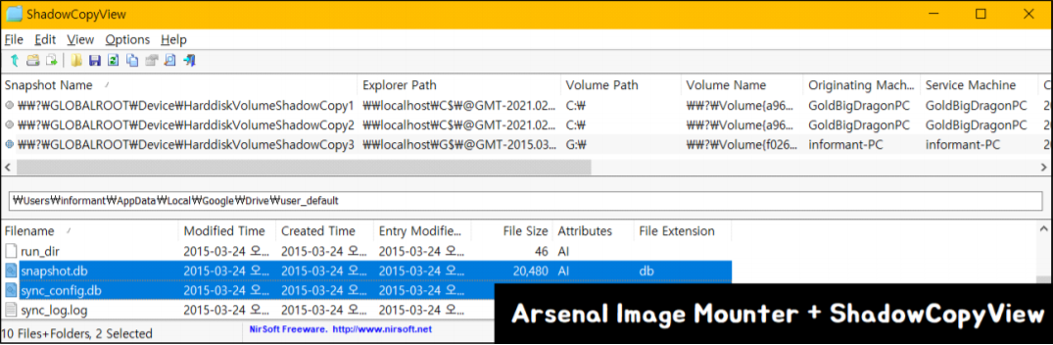

25/33
Process
sync_log.log
VSC
StikyNote
Chrome
SearchIndexer
Outlook
Eraser
Ccleaner
GoogleDrive
InternetExplorer
Word
Prefetch
Autopsy
Arsenal Image Mounter
CFReDS

Slide 26
26/33
Process
The judge lacks time to read the reports.
- 최원영 Mentor -
CFReDS

Slide 27
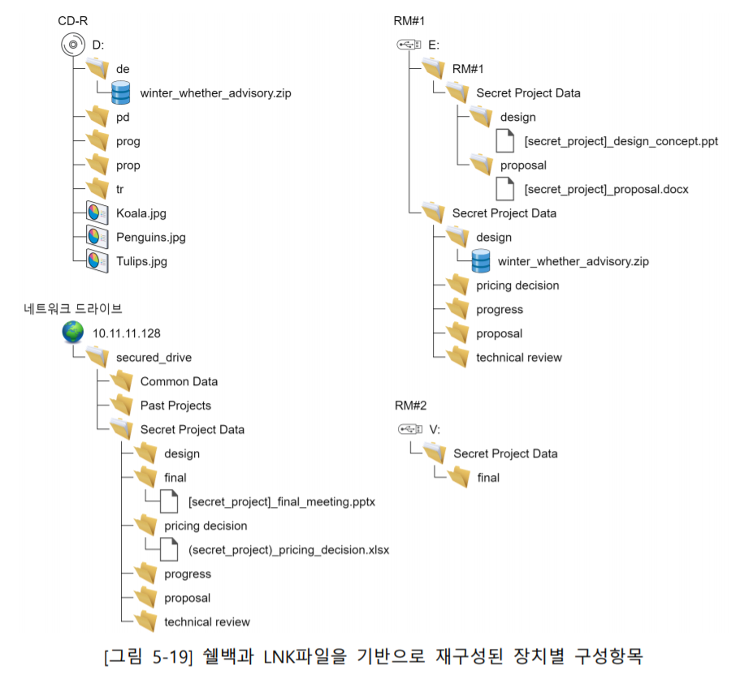
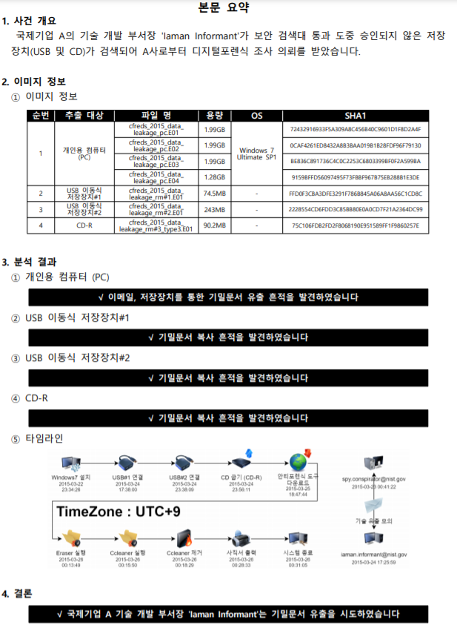
27/33
Process
CFReDS

Slide 28
28/33
Process
CFReDS

Slide 29
Result
CFReDS

Slide 30
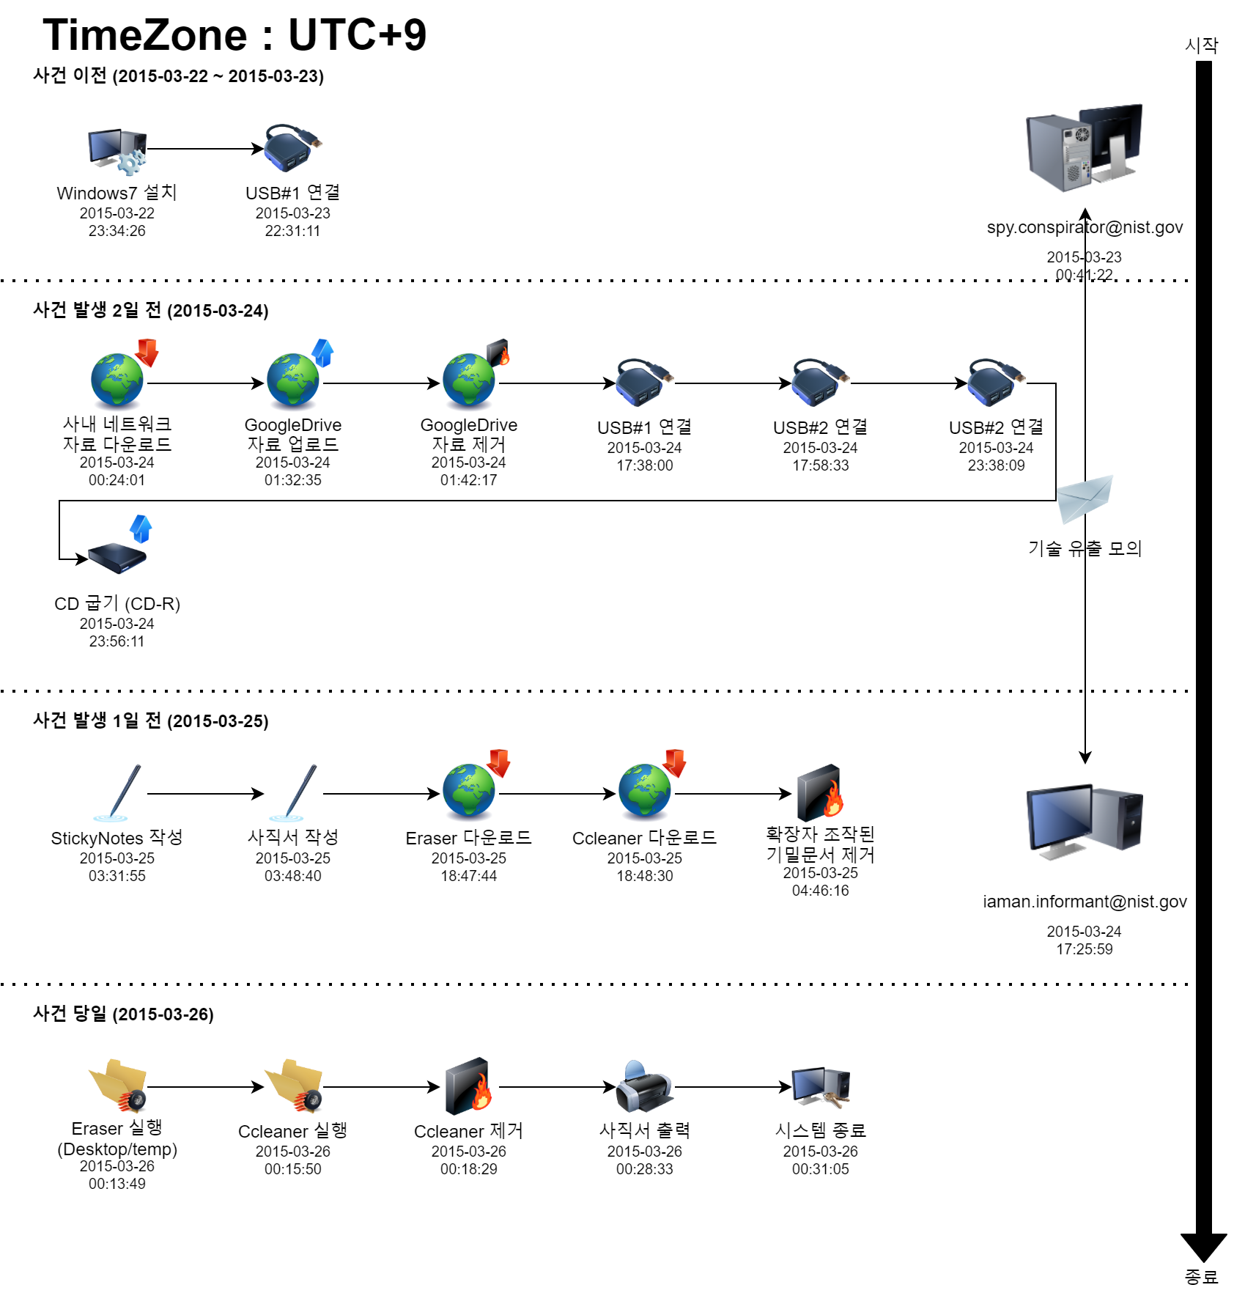
30/33
Result
CFReDS

Slide 31
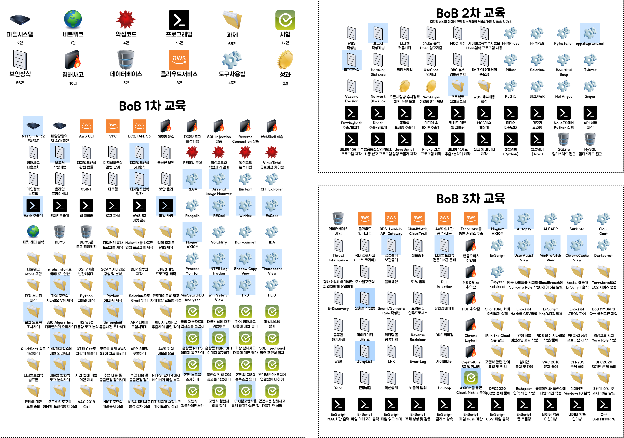
31/33
Result
약 20%가 CFReDS와
관련 있는 항목
CFReDS

Slide 32
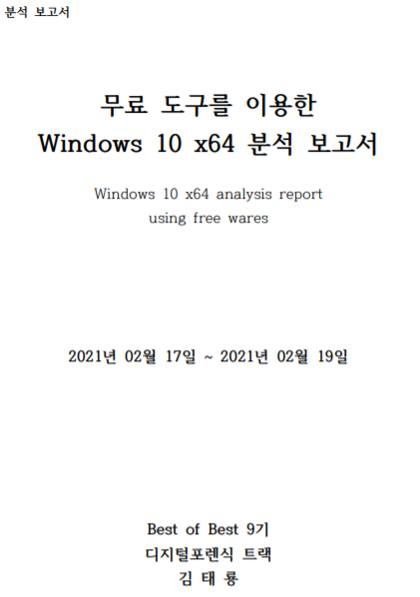
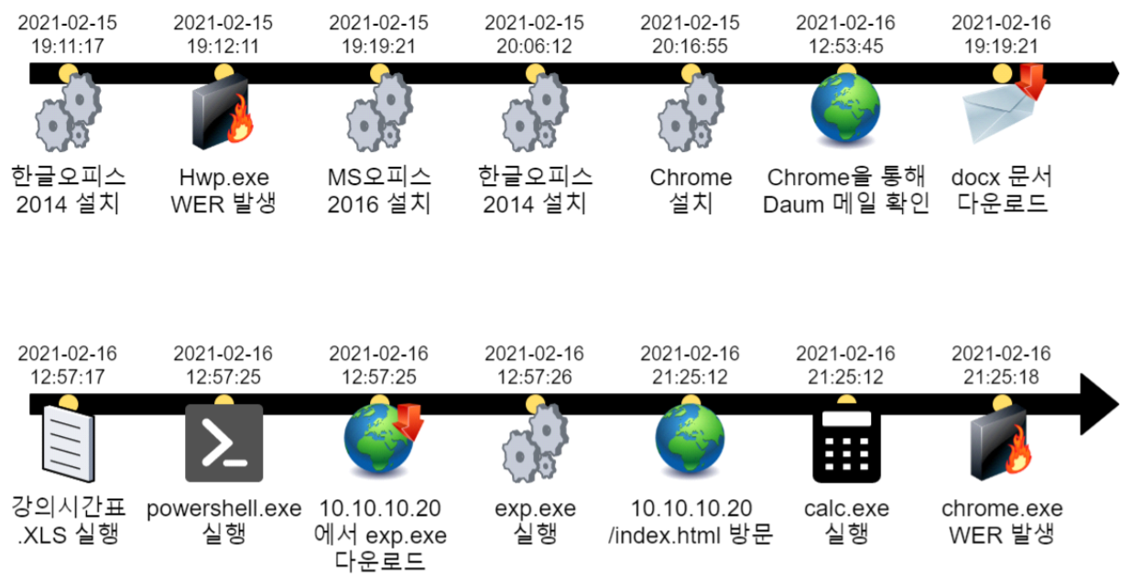
32/33
Result
CFReDS

Slide 33
Thankyou
CFReDS

